Slide 1

MSU-MCEST | 2026
MACHINE LEARNING-BASED SASE PERFORMANCE PREDICTION SYSTEM
By: Jerica Grace Estose &
Humaida Ampaso

Slide 2
MSU-MCEST | 2026
CHAPTER 1:
THE PROBLEM AND IT'S SETTINGS

Slide 3
MSU-MCEST | 2026
INTRODUCTION
College entrance exams greatly influence students’ educational opportunities and future careers.
Many countries use standardized exams such as the Gaokao (China), SAT/ACT (USA), and CSAT (South Korea).
In the Philippines, the MSU System uses the System Admission and Scholarship Examination (MSU-SASE) for student admission and scholarship qualification.
Mock exams and review programs help improve students’ performance, but not all students have access to these resources.
With the advancement of technology, Artificial Intelligence (AI) and Machine Learning (ML) can help analyze student data and predict academic performance.
This study, titled “Machine Learning-Based SASE Performance Prediction System,” aims to predict students’ possible SASE scores using their Grade 11–12 academic performance in Mathematics, Science, Language, and Aptitude-related subjects.

Slide 4
MSU-MCEST | 2026
STATEMENT OF THE PROBLEM
The lack of clear evidence on the relationship between students' performance in high school subjects - Mathematics, Science, Language, and Aptitude and their SASE scores makes it difficult to determine which subjects significantly influence exam performance
Current methods do not utilize students’ high school academic records in Mathematics, Science, Language, and Aptitude to predict SASE scores, which limits the early assessment of applicants’ potential performance and the provision of data-driven academic guidance.

Slide 5
MSU-MCEST | 2026
OBJECTIVES OF THE STUDY
Analyze the relationship between students’ performance in high school subjects aligned with the SASE areas of Mathematics, Science, Language, and Aptitude and their SASE scores.
This study aims to design and implement a machine learning–based predictive system that uses students’ high school academic records in Mathematics, Science, Language, and Aptitude to estimate SASE scores for early performance assessment and data-driven academic guidance.

Slide 6
MSU-MCEST | 2026
SCOPE AND LIMITATIONS OF THE STUDY:
Scope
This study focuses on the development of a web-based machine learning system that predicts students’ possible performance in the MSU-SASE. The system uses Grade 11 and Grade 12 academic records in Mathematics, Science, Language, and Aptitude-related subjects as input data. Historical academic records and SASE results from MSU-MCEST applicants during School Year 2023–2024 are used for training, testing, and validating the predictive model. The application is designed to help students, especially those without access to review programs, estimate their potential SASE performance.

Slide 7
MSU-MCEST | 2026
SCOPE AND LIMITATIONS OF THE STUDY:
Limitation
The study is limited to Grade 11 and Grade 12 students from MSU-MCEST, which may limit the applicability of the results to other campuses or institutions. Time constraints may also affect the size of the dataset used in the study. Some data are based on self-reported questionnaires, which may lead to biased responses. In addition, external factors such as home environment, mental health, and access to learning resources are not included in the model. The system is intended only for predictive analysis and does not provide academic interventions, recommendations, or long-term monitoring of students’ progress.

Slide 8
MSU-MCEST | 2026
CHAPTER 2:
REVIEW OF RELATED LITERATURE AND STUDIES

Slide 9
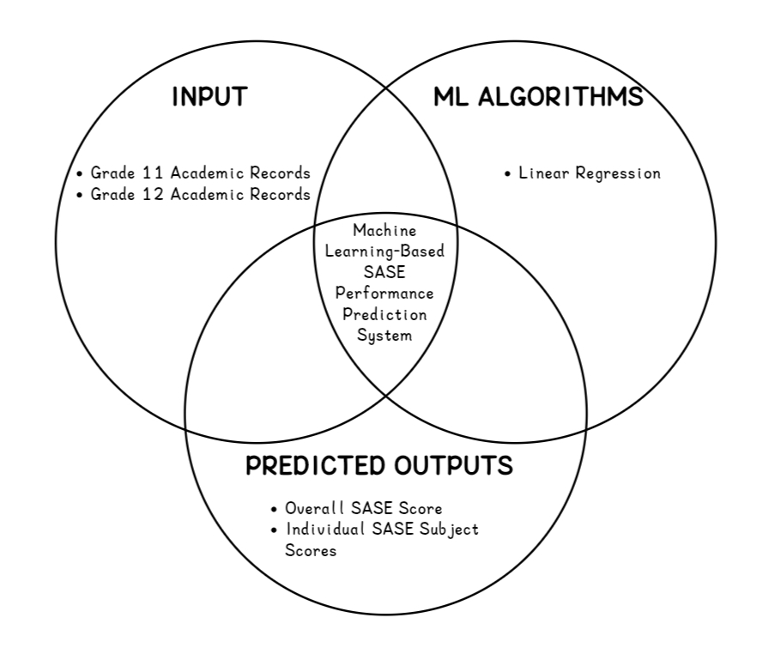
MSU-MCEST | 2026
SUMMARY OF THE RELATED LITERATURE

Slide 10
MSU-MCEST | 2026
CHAPTER 3:
RESEARCH METHODOLOGY

Slide 11
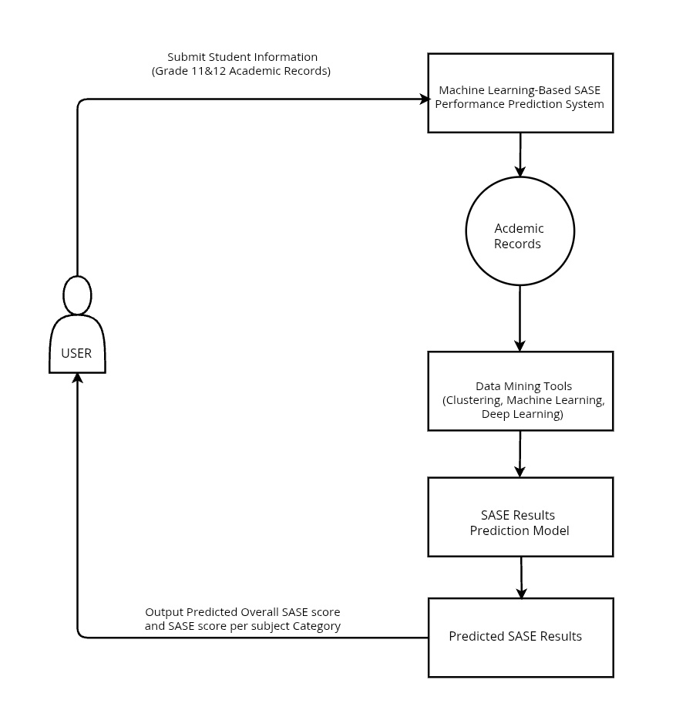
MSU-MCEST | 2026
Conceptual Framework

Slide 12
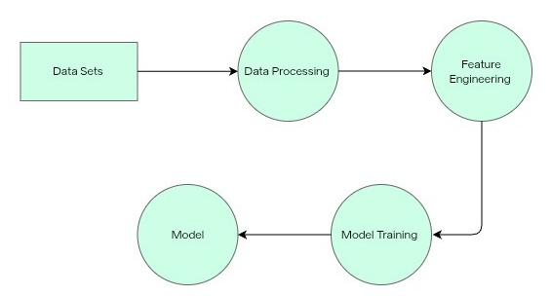
MSU-MCEST | 2026
Model Training Data Flow Diagram

Slide 13
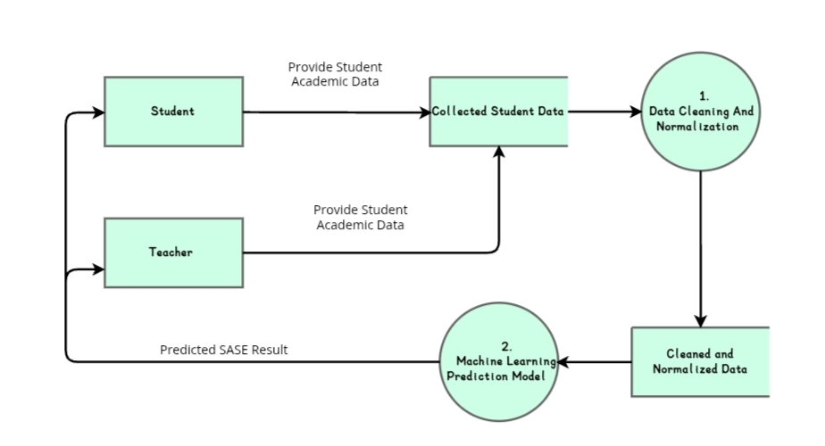
MSU-MCEST | 2026
Level 0
Data Flow Diagram

Slide 14
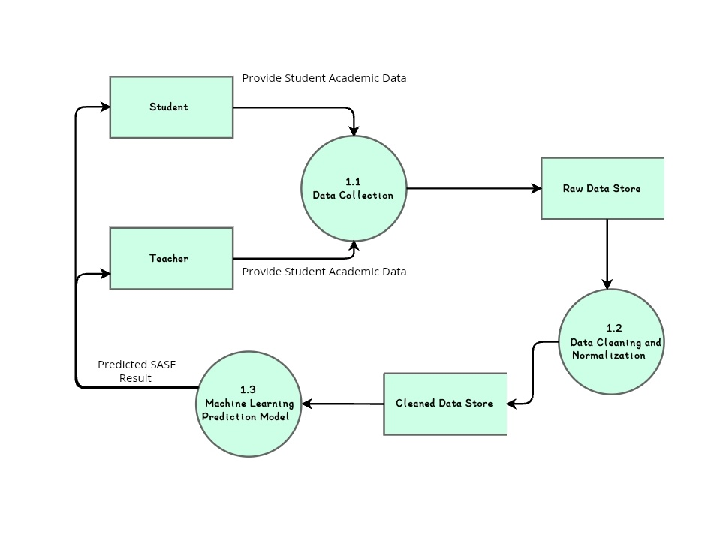
MSU-MCEST | 2026
Level 1
Data Flow Diagram

Slide 15
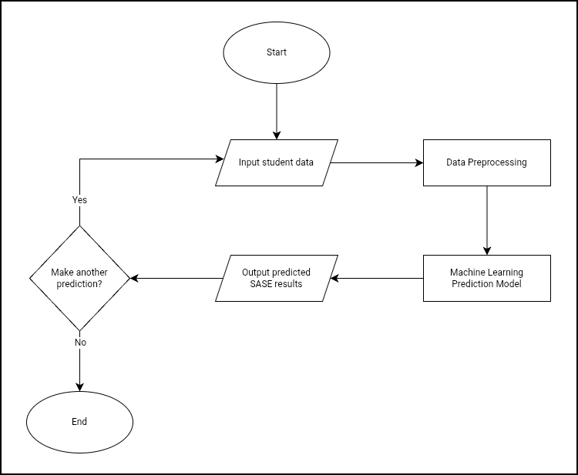
MSU-MCEST | 2026
Process Flow Diagram

Slide 16
MSU-MCEST | 2026
CHAPTER 4:
RESULTS AND DISCUSSIONS

Slide 17
MSU-MCEST | 2026
SURVEY RESULTS

Slide 18
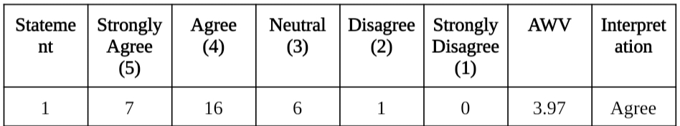
MSU-MCEST | 2026
Q1:The system is easy to use.

Slide 19
MSU-MCEST | 2026
Q2: The system interface is understandable.

Slide 20
MSU-MCEST | 2026
Q3: The navigation of the system is simple and user-friendly.

Slide 21
MSU-MCEST | 2026
Q4: The system responds quickly during use.

Slide 22
MSU-MCEST | 2026
Q5: The system processes data accurately.

Slide 23
MSU-MCEST | 2026
Q6: The system successfully generates prediction results.

Slide 24
MSU-MCEST | 2026
Q7: The features of the system function properly.

Slide 25

MSU-MCEST | 2026
Q8: The prediction results are easy to understand.

Slide 26
MSU-MCEST | 2026
Q9: The system helps assess examination readiness.

Slide 27
MSU-MCEST | 2026
Q10: The system is beneficial for students preparing for the MSU-SASE.

Slide 28
MSU-MCEST | 2026
Graphical User Interface

Slide 29
MSU-MCEST | 2026
CHAPTER 5:
SUMMARY, CONCLUSION AND RECOMMENDATION

Slide 30
MSU-MCEST | 2026
SUMMARY
The study developed a Machine Learning-Based SASE Performance Prediction System for Mindanao State University–Maigo College of Education, Science and Technology that helps students assess their possible MSU-SASE performance using Grade 11 and Grade 12 academic records in Mathematics, Science, Language, and Aptitude. The study utilized the Linear Regression algorithm to generate prediction results. The system successfully performed data processing, prediction, and result generation, and users found it easy to use and helpful in identifying strengths and areas for improvement. However, the study was limited by the small dataset and the exclusion of external factors that may also affect student performance.

Slide 31
MSU-MCEST | 2026
CONCLUSION
The researchers concluded that the Machine Learning-Based SASE Performance Prediction System successfully provided a data-driven method for estimating students’ potential performance in the MSU System Admission and Scholarship Examination. Using Grade 11 and Grade 12 academic records, the system generated prediction results through the Linear Regression algorithm. The web-based system improved student readiness assessment by offering fast, accessible, and easy-to-understand predictions, making it a useful academic support tool for students, teachers, and academic stakeholders. However, the results remain estimates due to data and variable limitations.

Slide 32
MSU-MCEST | 2026
RECOMMENDATION
The researchers recommend regular system maintenance and updates to ensure accuracy and reliability of the Machine Learning-Based SASE Performance Prediction System. Future studies should expand dataset collection from multiple academic cycles and include additional variables such as socioeconomic status, study habits, learning environment, and psychological factors to improve prediction results. More advanced machine learning models may also be explored to enhance accuracy. The system interface should continue to be improved for better accessibility and user experience, while training and user guidance should be provided to help students and educators properly use the system. Additional features such as personalized study recommendations may also be integrated, and educational institutions are encouraged to adopt the system as part of their academic support services.

Slide 33
MSU-MCEST | 2026
THANK YOU

